Slide 1
Reviewing National Guard and Reserve Claims for Proper Claims Processing
August 2025
Boise VARO
Notes:
Welcome to the Service Connection for National Guard and Reserves course. To advance each slide, click anywhere on the screen.

Slide 2
Objectives
Identify the different components of the United States Military
Be able to describe the differences between the Reserves and the National Guard
Demonstrate a comprehensive understanding of what is considered active duty and/or qualifying service for National Guardsmen and Reservists
Be able to distinguish between the different types of National Guard assignments
Determine the Veteran’s status on any specific date
Be able to properly review a National Guard claim and request the necessary opinions in order to appropriately adjudicate the claim.
Notes:
Objectives
Upon completion of this lesson, you will be able to:
Demonstrate a comprehensive understanding of what is considered active duty and or qualifying service for National Guard and Reserves.
Identify when a rating decision is the appropriate action to take.

Slide 3
References
38 CFR 3.6 — Duty periods
38 CFR 3.7 — Individuals and groups considered to have performed active military, naval, or air service
38 CFR 3.385 — Disability due to impaired hearing
38 CFR 3.307 — Presumptive service connection for chronic, tropical, or prisoner-of-war related disease, disease associated with exposure to certain herbicide agents, or disease associated with exposure to contaminants in the water supply at Camp Lejeune; wartime and service on or after January 1, 1947
38 CFR 3.309 — Disease subject to presumptive service connection
38 U.S.C. 106 — Certain service deemed to be active service
VAOPGCPREC 08-01 — Meaning of “injury” for Purposes of Active Service — 38 U.S.C. 101(24)
VAOPGCPREC 04-02 — Meaning of “injury” for Purposes of Active Service — 38 U.S.C. 101(24
_
_
_
_
_
_
Notes:
References
The references for this course are listed on the screen. You may click any hyperlinked references for further details.
38 CFR 3.6, Duty Periods.
38 CFR 3.7, Individuals and groups considered to have performed active military, naval, or air service.
M21 dash 1, Part Three, Subpart two.6..A, Establishing Veteran Status
M21 dash 1, Part Three, Subpart four.4.B.4.f. Considering National Guard and Reserve Duty for Hearing Loss and or Tinnitus Claims
M21 dash 1, Part Three, Subpart five.1.D, Willful Misconduct and Line of Duty
M21 dash 1, Part IV, Subpart two.2.B, Determining Service Connection

Slide 4
References Continued
M21-1 III.i.1.A. — Establishing Veterans Status
M21-1 II.iii.3.B. — System Updates at Intake
M21-1 X.v.1.C. — Administrative Decisions
M21-1 V.iii.2.B. — Conditions of the Auditory System
M21-1 V.ii.2. — Determining Service Connection
M21-1 X.iv.1.C. — Willful Misconduct and Line of Duty (LOD)
M21-1 IV.i.1.A. — Duty to Assist with Providing a Medical Examination or Opinion Smith (Valerie Y.) v. Shinseki, 24 Vet.App. 40, 44 (2010)

Slide 5
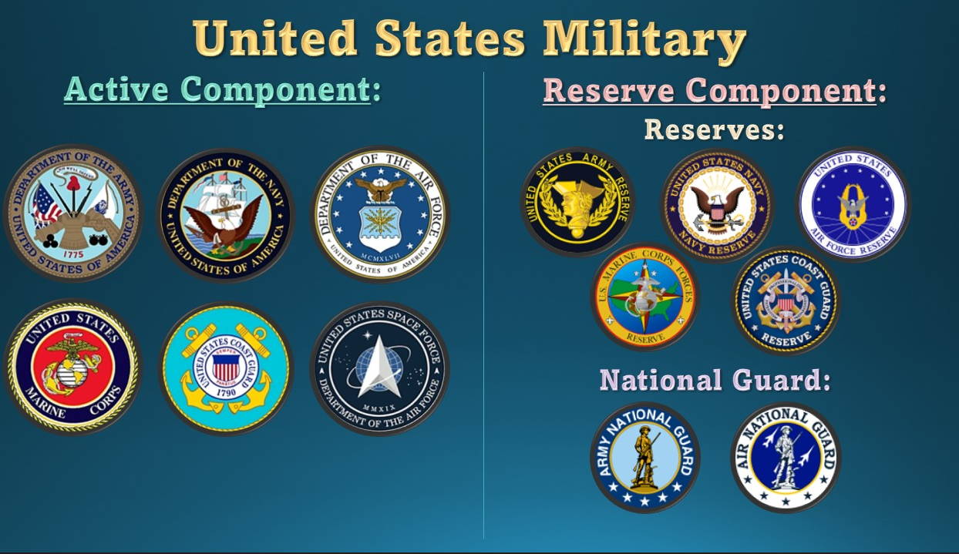
COMPONENTS OF THE UNITED STATES MILITARY

Slide 6

Components of the Military: Active Duty
Nation’s first line of defense
Largest component of the military
Six branches: Army, Air Force, Navy, Marines, Coast Guard and Space Force.
The Army is the oldest branch of the U.S. military, while Space Force is the newest
Each branch of the armed forces falls under the Department of Defense except for the Coast Guard, which is under Homeland Security
Notes:
branches

Slide 7
Components of the Military: Reserve Component
Second line of defense
Consists of two elements: the Reserves and the National Guard
Both are made up of part-time and full-time Service Members as well as civilian employees.

Slide 8

Reserves
All branches of the military have a Reserve element except for the Space Force.
Support or augment their Active-Duty counterparts in times of war, national emergencies and threats to national security, both stateside and overseas
Reserves can only be activated and funded by the Federal Government
Commander-in-Chief is the President of the United States

Slide 9
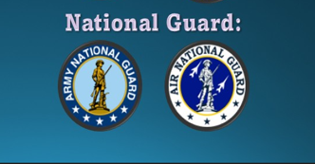
Reserve Component
Second arm of the Reserve Component and consists of both the Army and Air Force
Like the Reserves, members of the National Guard, or Guardsmen, are trained and ready to defend the nation during times of war, threats to national security and national emergencies.
National Guard is also called up for state emergencies. Because of this, and contrary to the Reserves, the National Guard reports to both the state and federal government
Two Commanders-in-Chief (Governor and the President of the United States)
Members of the National Guard can hold a variety of different statuses, which makes determining VA benefits difficult.

Slide 10
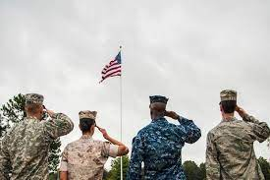
Definition
Veteran - a person who served in the active military, naval, air, or space service and who was discharged or released under conditions other than dishonorable (38 CFR 3.1 (d))

Slide 11
Types of Qualifying Service
Qualifying service is any type of service that qualifies or potentially qualifies a claimant for VA benefits such as:
Active duty
Any period of active duty for training (ADT) during which a person is disabled or dies from an injury or disease incurred or aggravated in the line of duty.
Any period of inactive duty for training (IADT) during which a person is disabled or dies from an injury incurred or aggravated in the line of duty or from any of the following conditions that occurred during training:
acute myocardial infarction
cardiac arrest, or
a cerebrovascular accident
OR an injury while proceeding directly due, or returning from, a period of ADT and IADT
Notes:
Qualifying Service
Active duty.
Any period of active duty for training (A D T) during which a person is disabled from a disease or injury incurred or aggravated in the line of duty.
Any period of inactive duty for training (I A D T) during which a person is disabled from an injury incurred or aggravated in the line of duty or from any of the following conditions that occurred during training:
acute myocardial infarction
cardiac arrest, or
a cerebrovascular accident.

Slide 12
National Guard and Reserve Service
Service as a National Guard member is not considered active service and is not adequate service upon which to establish Veteran status.
In order to establish service connection based on National Guard and Reserve status, the evidence must show a disease or injury incurred in or was aggravated by a period of active duty or active duty for training; or that an injury incurred in or was aggravated by a period of inactive duty for training.
Simply having a medical condition or injury arise while being a member of the National Guard or Reserves is not sufficient to establish service connection.
Notes:
National Guard and Reserve Service
Service as a traditional Reservist or National Guard member is not active service and is not adequate service upon which to establish Veteran status.
This service includes performing one period of weekend drill monthly and two weeks of annual training (A T) yearly. This service is referred to as
I A D T, which includes traditional drill weekends, and
A D T, which includes the
initial period of basic training and specialized job skill training, and
two week A T period.

Slide 13
ACTIVE DUTY FOR TRAINING
Definition: A tour of duty which is used for training members of the Reserve Components to provide trained units and qualified persons to fill the needs of the Armed Forces in time of war or national emergency and such other times as the national security requires. This includes Annual Training, special tours of Active Duty for Training, school tours, and the initial duty for training performed by non-prior service enlistees. (Also called ADT or ACDUTRA)

Slide 14
INACTIVE DUTY TRAINING
Definition: Authorized training performed by a member of a Reserve Components not on Active Duty or Active Duty for Training and consisting of regularly scheduled unit training assemblies, or additional training assemblies (weekend drills)

Slide 15
In-service Injury
For the purposes of considering a claim for SC for posttraumatic stress disorder, a sexual assault that occurred during IADT is considered an “injury.”
A disabling condition as a result of administration of an anthrax vaccination during inactive duty training may be considered disabled by an “injury” incurred during such training.
Notes:
In-service Injury
For the purposes of considering a claim for SC for posttraumatic stress disorder, a sexual assault that occurred during I A D T is considered an injury.
A disabling condition as a result of administration of an anthrax vaccination during inactive duty training may be considered disabled by an “injury” incurred during such training.

Slide 16
Academy Attendees
United States Military, Air Force, or Naval Academy Preparatory School
If a(n) … | Enters service … | Then that service is characterized as …
member of the National Guard, or Reserves | for the sole purpose of attending the academy | ADT. Exception: If the service member continues on to active duty after the academy, consider the academy time as active duty.
civilian | for the sole purpose of attending the academy | ADT. Exception: If the service member continues on to active duty after the academy, consider the academy time as active duty.
active duty service member | without receiving a release from active duty | active duty.
Notes:
Academy Attendees
United States Military, Air Force, or Naval Academy Preparatory School
If a member of the National Guard, or Reserves
Enters service for the sole purpose of attending the academy
Then that service is characterized as A D T.
Exception: If the service member continues on to active duty after the academy, consider the academy time as active duty.
If a civilian
Enters service for the sole purpose of attending the academy
Then that service is characterized as A D T.
Exception: If the service member continues on to active duty after the academy, consider the academy time as active duty.
If an active duty service member
Enters service without receiving a release from active duty
Then that service is characterized as active duty.

Slide 17
3 Different Types of Guard/ Reserve Assignments
“Traditional” Guardsman or Reservist
- Initial period of basic training and specialized job skill training, (may be split)
- Participates in weekend drills (IADT) and Two-week annual training (ADT)
- A service-connected disability will turn IADT/ADT into “Active Duty”
- DD Form 214 is issued for periods of ADT (i.e.) Basic Training. Although Annual Training is considered to be ADT, no DD form 214 is issued.
- NGB 22 is issued for other duty service verification
Eligible to receive retirement after age 60
May be put on orders temporarily when federally activated under Title 10; or may be put on orders temporarily when state activated under Title 32 for ADSW (Active Duty for Special Work) or ADOS ( Active Duty for Operational Support)

Slide 18
3 Different Types of Guard/Reserve Assignments
Civilian Employee/ Technician
Civil Service Employee who wears military uniform during the 40-hour work week
Also obligated to be a member of the Guard/Reserves and participate in weekend drills and annual summer training
Are covered under WORKERS COMPENSATION for injuries sustained AT WORK
- A service-connected disability will turn IADT/ADT into “Active Duty”
- DD Form 214 is issued for periods of ADT (i.e.) Basic Training. Although Annual Training is considered to be ADT, no DD form 214 is issued.
- NGB 22 is issued for other duty service verification
Eligible to receive retirement after age 60
May be put on orders temporarily when federally activated under Title 10; or may be put on orders temporarily when state activated under Title 32 for ADSW (Active Duty for Special Work) or ADOS ( Active Duty for Operational Support)

Slide 19
3 Different Types of Guard/ Reserve Assignments
Full time AGR (Active Guard Reserve)
For National Guardsman this assignment is considered to be fulfilling an Active Duty position, except for it is considered to be Active Duty for Training, no matter how long it lasts (Title 32)
They remain under the command and control of their state or territory Governor
- Receive same military pay, military benefits, and military retirement.
- Must also participate in weekend drills and annual training
- Will receive a DD Form 214 for each period of AGR
AGR for National Guard is not qualifying service UNTIL incurrence or aggravation of one disability is accepted by the VA . Once this happens, the WHOLE period of service turns into Active Duty for VA purposes
****For Reservists, AGR is considered to be Active Duty and for the WHOLE period of service (Title 10)

Slide 20
What if there’s no DD 214??
Personnel File:
Retirement Points Annual Statement. This is the most complete reflection of all periods of verified service for an individual, including periods of Active Duty, ADT, and IADT
Military orders
Service Treatment Records documenting that a member was injured during a period of ADT or IADT
An official order directing the member to a period of Annual Training, or
a pay stub documenting the period of service
Other service records may be utilized to verify periods of ADT and IADT if the information provided
reflects the type of service
documents the dates of the period of service, and
does not otherwise conflicting with the remaining evidence of record.

Slide 21
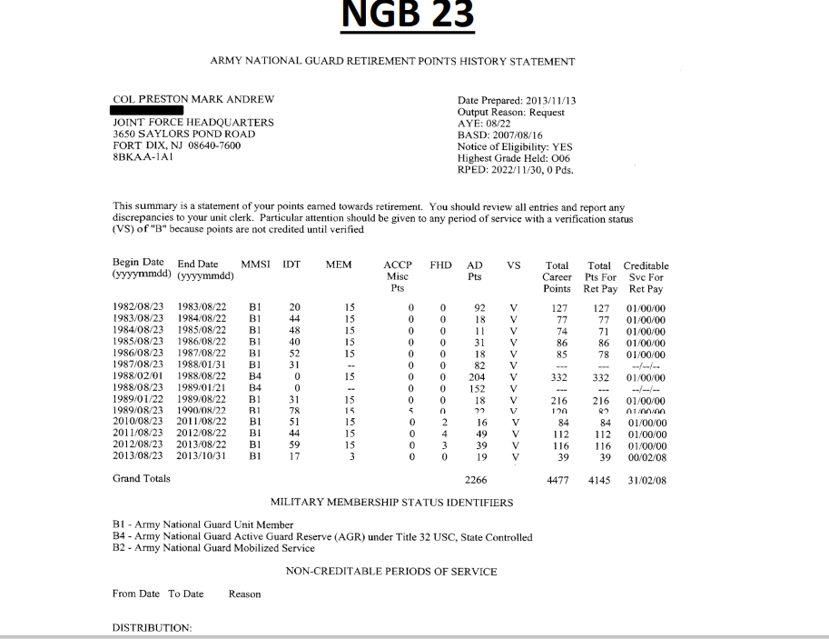



Slide 22
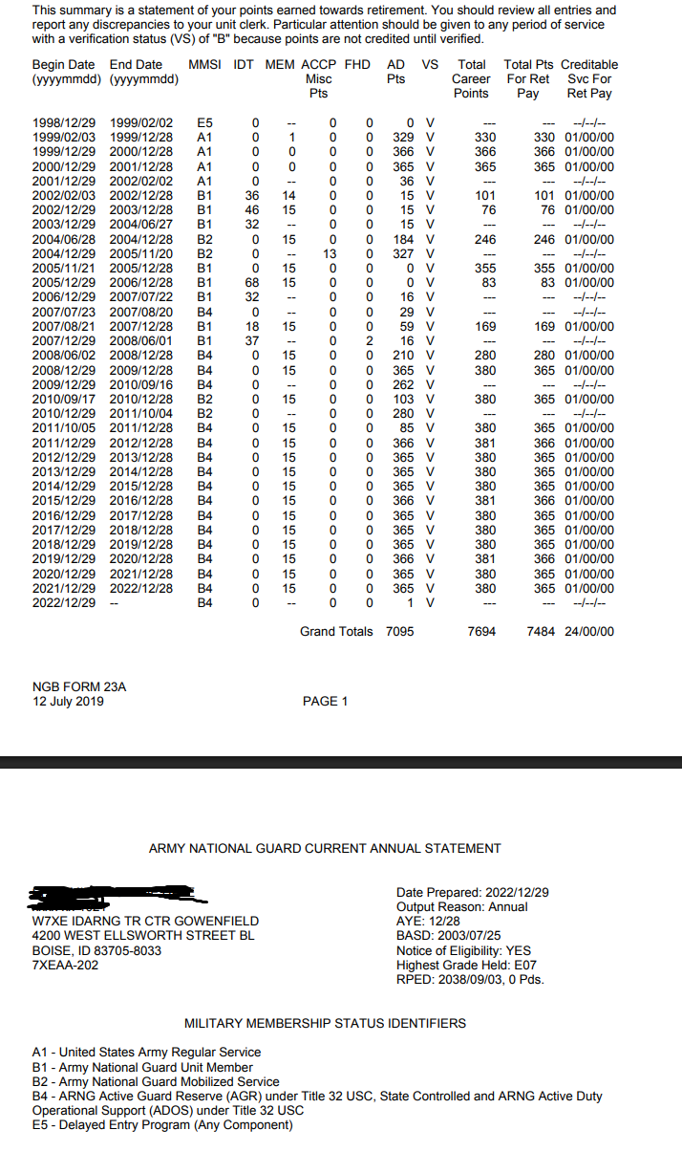

Slide 23
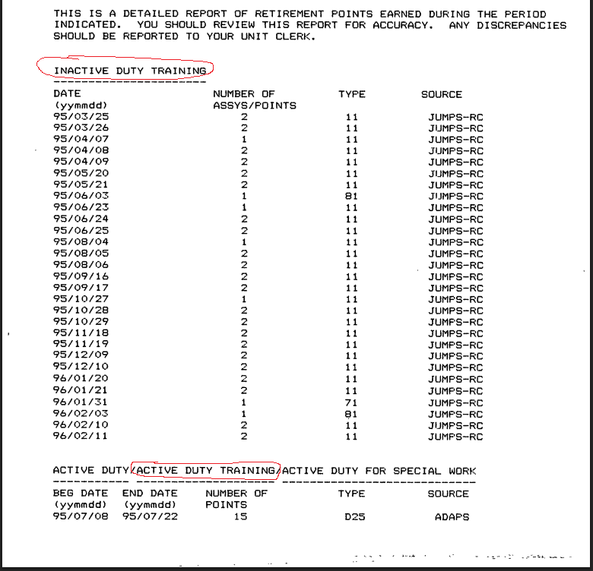

Slide 24
Line of Duty Determinations
Formal line of duty investigations are documented on DD Form 261
form must be complete, and
bear the signature of the final approval authority
Not all injuries or diseases, incurred or aggravated in the line of duty will be documented on DD Form 261.
A formal line of duty investigation is not a requirement to establish that a disease or injury was incurred or aggravated in the line of duty during a period of ADT or IADT.
DO NOT USE THE LACK OF AN LINE OF DUTY DETERMINATION AS SOLE REASON FOR DENYING A CLAIM FOR SERVICE CONNECTION
Notes:
Deciding Line of Duty Status
Formal line of duty investigations are documented on DD Form 2 61.
Not all injuries or diseases, incurred or aggravated in the line of duty will be documented on DD Form 2 61.
A formal line of duty investigation is not a requirement to establish that a disease or injury was incurred or aggravated in the line of duty during a period of A D T or I A D T.

Slide 25
Line of Duty Continued
“In the line of duty” does not always mean while the Reservist or National Guard member was at work. For Reserve and Guard members, travel directly to and from the place of inactive duty training (IDT) or drill, as well as overnight stays immediately before or between successive periods of drill, are generally considered within a duty status for LOD purposes.
Individuals with AGR service, including in the National Guard, are on continuous duty 24 hours a day, seven days a week just as are their active-duty counterparts. Therefore, AGR cases will most likely not have any LOD investigation performed.
If no intentional negligence or willful misconduct is noted, an injury or disease that occurs during AGR service is presumed to be in the line of duty.
Notes:
Line of Duty continued
“In the line of duty” does not always mean while the Reservist or National Guard member was at work.
Individuals with A G R service, including in the National Guard, are on continuous duty 24 hours a day, seven days a week just as are their active duty counterparts.
If no intentional negligence or willful misconduct is noted, an injury or disease that occurs during A G R service is presumed to be in the line of duty.

Slide 26
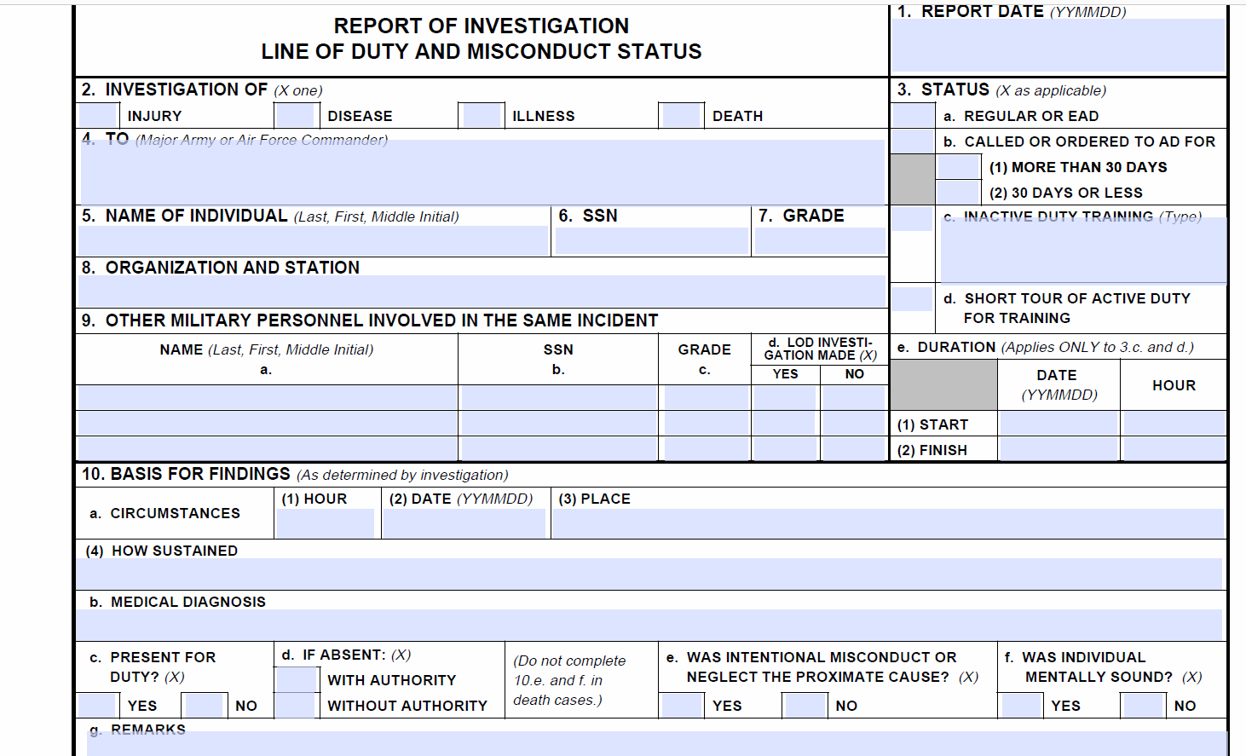
DD 261

Slide 27
AGR Review Findings
TREND #1
VSRs/RVSRs are prematurely deciding that the AGR period is not qualifying service before they order the VAE and therefore, they do not order the VAEs/MO correctly.
Instead of looking at the period of AGR service as not qualifying from the beginning, the VSRs/RVSRs need to treat the period of AGR service as if it IS qualifying service when doing their initial review of the file. If they find an injury/disease that the Veteran is claiming took place in the STRs, then the VSR/RVSRs should order the VAEs and MOs accordingly, just like we would for any other Active-Duty Veteran. THEN, after the exams come back and IF we can grant one thing from that period of AGR service, then the entire period of AGR/Title 32 service becomes active duty for VA purposes.
(38 CFR 3.6, 38 CFR 3.159, M21-1, Part IV, Subpart i, Chapter 1, Section B - Evidentiary Standards for Finding an Examination or Opinion Necessary)

Slide 28
AGR Review Findings
TREND #2
RVSRs must determine if there are injuries/diseases related to period of AGR/Title 32 service by requesting a VAE/MO and asking the examiner if the disability is related to the event which happened on a specific date. However, the examiners will often provide negative opinions based on the following rationale, “This injury is not related because the Veteran was not on AD at the time of the injury.”
If we receive a rationale like the one above, then we MUST return the opinion.
“It is the duty of the VA to determine whether the Veteran’s service is qualifying active service. The determination regarding the type of service is not a medical decision and is not the responsibility of the VA examiner. The Veteran sustained a right knee injury during a Drill Weekend with the National Guard on April 6, 2024.
Please answer the previously requested opinion regarding whether the current right knee condition is at least as likely as not related to the right knee injury which took place on April 6, 2024.”
(IV.i.3.C.1.a. Insufficient Examination Reports; 38 CFR 4.2; 38 CFR 4.6)

Slide 29
AGR Review Findings
TREND #3
RVRS believe that an LOD determination is required for injuries/diseases that took place during a period of AGR service and are erroneously denying conditions that incurred during AGR service. However, LOD Determinations are not technically “required” for ANY period of service.
Individuals with AGR service, including in the National Guard, are on continuous duty 24 hours a day, seven days a week just as are their active-duty counterparts. Therefore, AGR cases will most likely not have any LOD investigation performed.
REMEMBER: Once a disability that arose from the AGR service is service connected, THEN that period of AGR service becomes qualifying service.
(III.i.1.A.2.e. Service Department Records for Verifying Periods of ADT and IADT; III.i.1.A.2.f. Deciding Line of Duty Status for Claims Based on ADT or IADT)

Slide 30
Hearing Loss and/or Tinnitus Claims
Claims for SC of hearing loss and/or tinnitus due to service in the National Guard or Reserves should be considered under the same criteria as any claim for SC of hearing loss and/or tinnitus. The condition must be causally related to service.
First, consider SC on the basis of a potential relationship to periods of active duty or active duty for training (ADT).
When SC for hearing loss and/or tinnitus may not be directly related to a period of active duty or extended ADT, entitlement to SC may still be established if there has been a decrease in auditory acuity due to military duties as a member of the National Guard or Reserves.
SC for hearing loss and/or tinnitus can be established for inactive duty for training (IADT) if the condition can be linked to an injury during IADT as shown by the nature of service, MOS, lay evidence, or other competent evidence.
Notes:
Hearing Loss and or Tinnitus Claims
Claims for SC of hearing loss and or tinnitus due to service in the National Guard or Reserves should be considered under the same criteria as any claim for SC of hearing loss and or tinnitus. The condition must be causally related to service.
First, consider SC on the basis of a potential relationship to periods of active duty or active duty for training (A D T).

Slide 31
Example of NG/Reserve Hearing Loss Opinion Request
Veteran was in the Active Army from 03/23/1962 to 03/22/1966. Veteran was then in the National Guard from 02/12/1971 to 02/23/1985 and was a helicopter mechanic and pilot one weekend a month and 2 weeks in the summer (for VA purposes).
Veteran also was exposed to helicopters daily for 8 years as a civilian.
Please evaluate these conditions and give opinion as to whether the Veteran's current hearing loss and tinnitus, if any, are at least as likely as not related to his noise exposure on Active Army military service and/or during his weekend drills and summer training with the National Guard.

Slide 32
SC Based on Multiple Periods of ADT or IADT
In circumstances where a claimed disability arises as a result of injuries, diseases, or covered conditions incurred in or aggravated during multiple periods of ADT or IADT, only the specific periods of ADT or IADT are considered active service.
Example: SC is warranted for hearing loss based on noise exposure sustained during a claimant’s 20-year career in the Reserves. The entire 20-year span is not considered active service. Rather, only the individual periods of ADT and or IADT during which the noise exposure (which is the conceded in-service injury in these situations) occurred are considered active service.
Notes:
SC Based on Multiple Periods of A D T or I A D T
In circumstances where a claimed disability arises as a result of injuries, diseases, or covered conditions incurred in or aggravated during multiple periods of A D T or I A D T, only the specific periods of A D T or I A D T are considered active service.
Example: SC is warranted for hearing loss based on noise exposure sustained during a claimant’s 20 year career in the Reserves. The entire 20 year span is not considered active service. Rather, only the individual periods of A D T and or I A D T during which the noise exposure (which is the conceded in-service injury in these situations) occurred are considered active service.

Slide 33
Identifying the Period of Service as Active
When SC for disability or death has been established based on a period of ADT or IADT, the rating activity will identify this period as active service by using the Special Notations box on the Codesheet and identifying
• the dates of service, and
• an explanation of the reason for establishing this period as active service.
Example: Service in the Army National Guard from January 16-17, 2016, is now considered active service based on the grant of SC for right knee ACL injury that was incurred in the line of duty during this period of service.
To ensure the rating Narrative and Codesheet accurately reflect the period(s) of ADT or IADT that now qualify as active service, refresh the VBMS Rating profile while drafting the rating decision (if necessary) after the military service updates are made in VBMS Core
Note: If the period of ADT or IADT upon which the grant of SC is based is a single day of ADT or IADT (the claimant was only called to a one-day period of ADT or IADT), utilize the day following as the end date of service but clearly annotate the Special Notation box to reflect that the service was actually only one single day of service.

Slide 34
Presumption of Soundness
The presumption of soundness does not automatically apply to all periods of ADT and IADT.
Presumption of soundness only applies when the Veteran underwent a physical examination at the time of entry into the period of Active Duty for Training on which the claim is based.
If an examination was performed, consider the Veteran to have been in sound condition when entering Active Duty for Training except as to defects, infirmities, or disorders noted on the examination report.
Notes:
Presumption of Soundness
The presumption of soundness does not automatically apply to all periods of A D T and I A D T.
Presumption of soundness only applies when the Veteran underwent a physical examination at the time of entry into the period of active duty for training on which the claim is based.

Slide 35
Aggravation
The presumption of aggravation is triggered when a Veteran establishes that a preexisting condition, which was noted upon entry into service, worsens during service.
For a period of ADT or IADT, the evidence must also show that the worsening was caused by the period of ADT or IADT and was NOT the result of natural progression of the disability.
Notes:
Aggravation
The presumption of aggravation is triggered when a Veteran establishes that a preexisting condition, which was noted upon entry into service, worsens during service.
Since A D T or I A D T service does not satisfy the requirements for Veteran status and associated active service, the presumption of aggravation does not apply.
For a period of A D T or I A D T, the evidence must additionally show that the worsening was caused by the period of A D T or I A D T.

Slide 36
Presumptive SC
If SC for a disability due to a disease or injury is established based on a period of ADT or
SC for a disability is established based on an injury or myocardial infarction, cardiac arrest, or cerebrovascular accident based on a period of IADT,
Then the ADT or IADT is considered active service and may be utilized in determining whether the applicability criteria have been met for the presumptive claim.
Notes:
Presumptive SC
If SC for a disability due to a disease or injury is established based on a period of A D T or
SC for a disability is established based on an injury or myocardial infarction, cardiac arrest, or cerebrovascular accident based on a period of I A D T,
Then the A D T or I A D T is considered active service and may be utilized in determining whether the applicability criteria have been met for the presumptive claim.

Slide 37
Presumptive SC
Presumptive SC has three applicability criteria, including
Veteran status
service in the active military, naval, or air service, and
service of 90 days or more
during a period of war, or
after December 31, 1946.
Per §3.307, this criteria must be met for consideration under §3.309. The ADT and/or IADT may be considered active service, but you cannot grant SC based on §3.309 unless that specific period of active service meets this criteria
Notes:
Presumptive SC
Presumptive SC has three applicability criteria, including
Veteran status
service in the active military, naval, or air service, and
service of 90 days or more
during a period of war, or
after December 31, 1946.

Slide 38
EXAMPLE
A Veteran establishes SC for bladder cancer as a result of exposure to contaminated water at Camp Lejeune during a period of ADT that extended for more than 90 days under 38 CFR 3.307(a)(7) and 38 CFR 3.309(f). The Veteran develops amyotrophic lateral sclerosis (ALS) and claims SC for the disease. By virtue of the grant of SC for a disability associated with the period of ADT, the ADT is considered active service and the Veteran is now eligible for presumptive SC for ALS under 38 CFR 3.318.

Slide 39
QUESTION
A Veteran is service connected for a shoulder injury that took place during the two-week Annual Training and therefore, the two-week period of ADT became Active Duty for VA purposes. Six months after this period of service, the Veteran develops hypothyroidism at a compensable level. Can hypothyroidism be presumptively service connected under 38 CFR 3.309(a)?

Slide 40

No, the Veteran is not entitled to presumptive service connection since the period of “active” service was less than 90 days, which is required per 38 CFR 3.307(a)(1) .

Slide 41
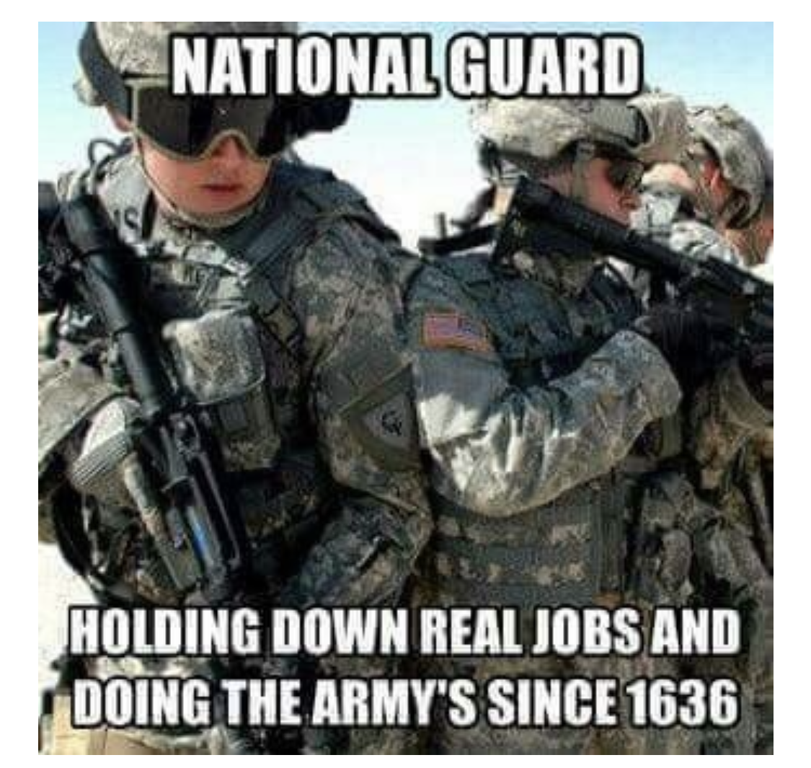

Slide 42
Questions??
Notes:
Questions?

